Slide 1
Bias-Corrected Q-Learning
With Multistate Extension
Donghun Lee ,Warren B. Powell , IEEE TRANSACTIONS ON AUTOMATIC CONTROL
授課教授： 李慶鴻 教授
講者： 曾揚
日期： 2021/5/10

Slide 2
Introduction
1. Introduce Q-learning shortly.
2. What’s happened?
3. How to correct it?
4. Discussion of the author.
5. Discussion for final.

Slide 3
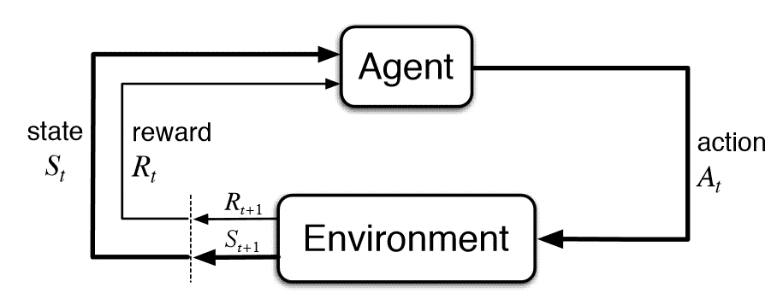
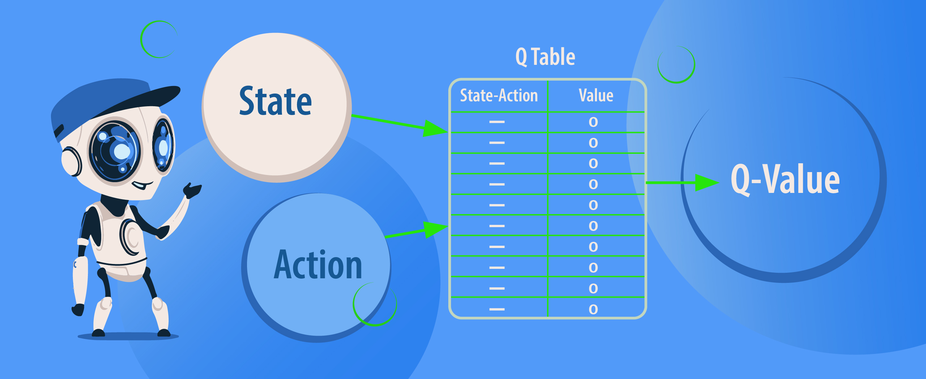
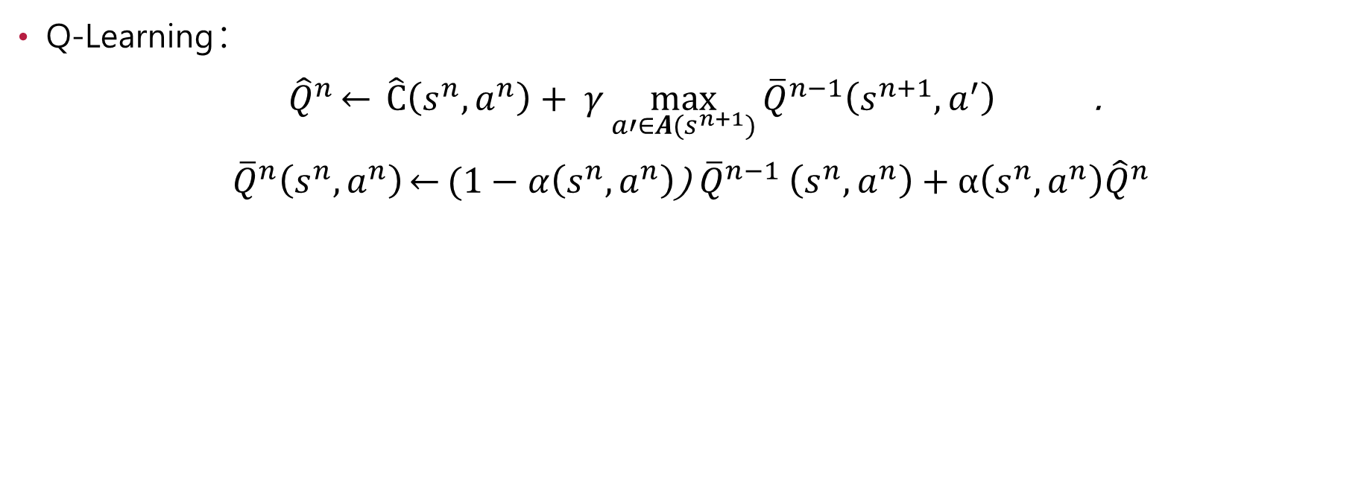
What’s happened?
Q-Learning :
${\hat{Q}}^{n}\overset{←}{} \hat{C}\left(s^{n},a^{n}\right)+ γ\max_{a′∈A(s^{n+1})}{{\overline{Q}}^{n−1}\left(s^{n+1},a^{′}\right)}$ .
${\overline{Q}}^{n}\left(s^{n},a^{n}\right)\overset{←}{}(1−α\left(s^{n},a^{n}\right)$) ${\overline{Q}}^{n−1}$ $\left(s^{n},a^{n}\right)+α\left(s^{n},a^{n}\right){\hat{Q}}^{n}$

Slide 4
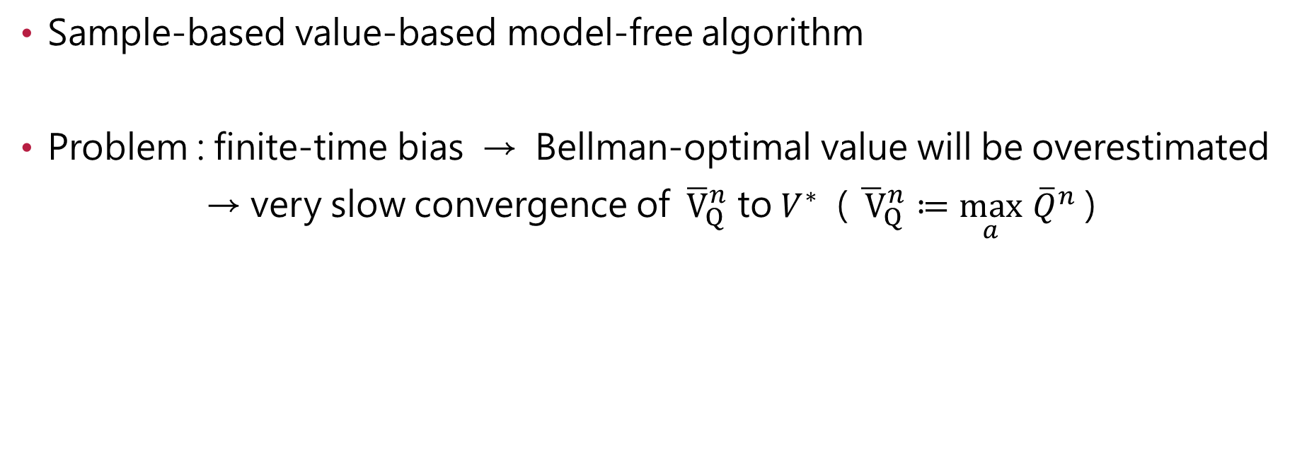
What’s happened?
Sample-based value-based model-free algorithm
Problem : finite-time bias → Bellman-optimal value will be overestimated
→ very slow convergence of ${\overline{V}}_{Q}^{n}$ to $V^{∗}$ ( ${\overline{ V}}_{Q}^{n}≔\max_{a}$ ${\overline{Q}}^{n}$ )

Slide 5
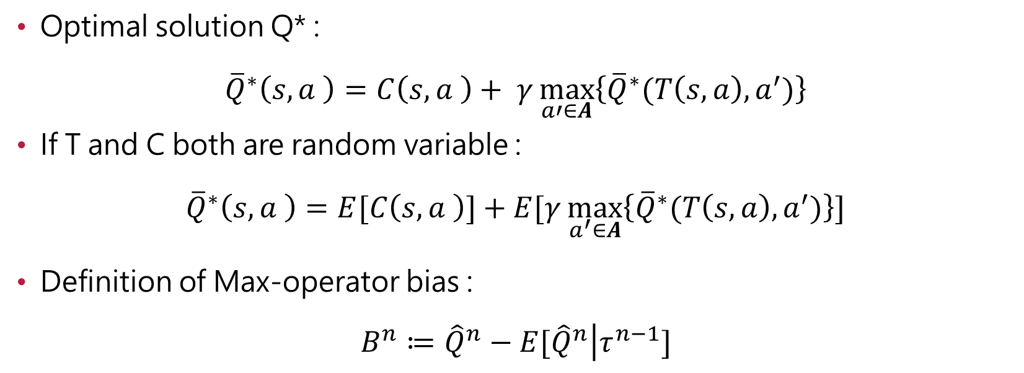
What’s happened?
Optimal solution Q* :
$${\overline{Q}}^{∗}\left(s,a \right)=C\left(s,a \right)+ γ\max_{a′∈A}\left\{{\overline{Q}}^{∗}(T\left(s,a\right),a^{′})\right\}$$
If T and C both are random variable :
$${\overline{Q}}^{∗}\left(s,a \right)=E[C\left(s,a \right)]+E[γ\max_{a^{′}∈A}\left\{{\overline{Q}}^{∗}(T\left(s,a\right),a^{′})\right\}]$$
Definition of Max-operator bias :
$$B^{n}≔{\hat{Q}}^{n}−E[{\hat{Q}}^{n}\left|τ^{n−1}\right.]$$

Slide 6
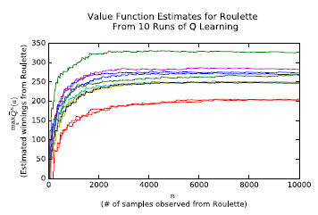
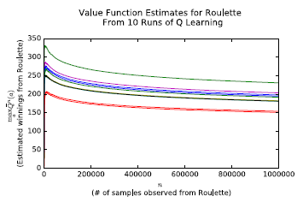
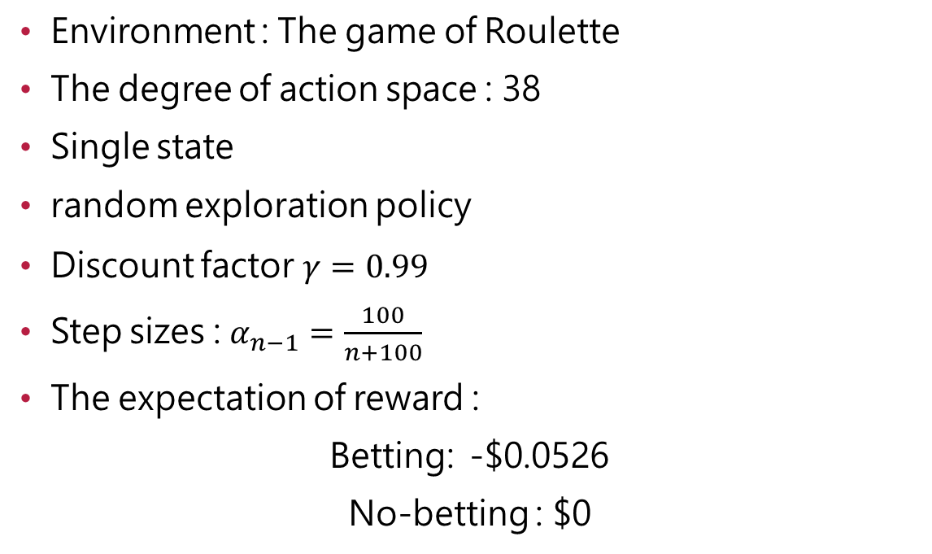
Max-operator bias
Environment : The game of Roulette
The degree of action space : 38
Single state
random exploration policy
Discount factor $γ=0.99$
Step sizes : $α_{n−1}=\frac{100}{n+100}$
The expectation of reward :
Betting: -$0.0526
No-betting : $0

Slide 7
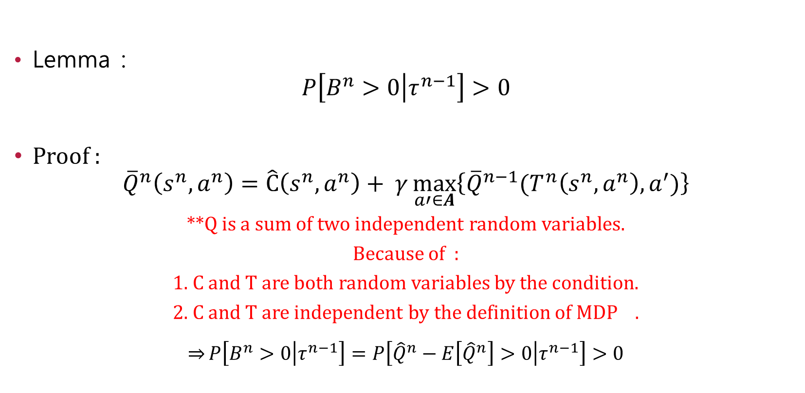
Max-operator bias
Lemma :
$$P\left[B^{n}>0\left|τ^{n−1}\right.\right]>0$$
Proof :
$${\overline{Q}}^{n}\left(s^{n},a^{n}\right)=\hat{C}\left(s^{n},a^{n}\right)+ γ\max_{a′∈A}\left\{{\overline{Q}}^{n−1}(T^{n}\left(s^{n},a^{n}\right),a^{′})\right\}$$
**Q is a sum of two independent random variables.
Because of :
1. C and T are both random variables by the condition.
2. C and T are independent by the definition of MDP .
$$\overset{⇒}{}P\left[B^{n}>0\left|τ^{n−1}\right.\right]=P\left[{\hat{Q}}^{n}−E\left[{\hat{Q}}^{n}\right]>0\left|τ^{n−1}\right.\right]>0$$

Slide 8
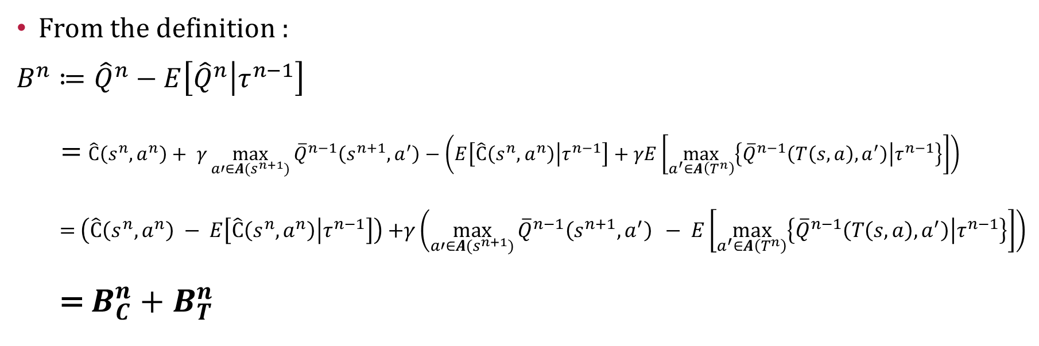
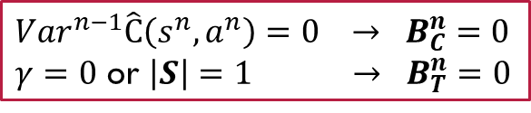
Max-operator bias
From the definition :
$$B^{n}≔{\hat{Q}}^{n}−E\left[{\hat{Q}}^{n}\left|τ^{n−1}\right.\right]$$
= $\hat{C}\left(s^{n},a^{n}\right)+ γ\max_{a′∈A(s^{n+1})}{{\overline{Q}}^{n−1}\left(s^{n+1},a^{′}\right)}−\left(E\left[\hat{C}\left(s^{n},a^{n}\right)\left|τ^{n−1}\right.\right]+γE\left[\max_{a^{′}∈A\left(T^{n}\right)}\left\{{\overline{Q}}^{n−1}\left(T\left(s,a\right),a^{′}\right)\left|τ^{n−1}\right.\right\}\right]\right)$
  = $\left(\hat{C}\left(s^{n},a^{n}\right) − E\left[\hat{C}\left(s^{n},a^{n}\right)\left|τ^{n−1}\right.\right]\right)$ +$γ\left(\max_{a′∈A(s^{n+1})}{{\overline{Q}}^{n−1}\left(s^{n+1},a^{′}\right)} − E\left[\max_{a^{′}∈A\left(T^{n}\right)}\left\{{\overline{Q}}^{n−1}\left(T\left(s,a\right),a^{′}\right)\left|τ^{n−1}\right.\right\}\right]\right)$
  = $B_{C}^{n}+B_{T}^{n}$
${Var}^{n−1}\hat{C}\left(s^{n},a^{n}\right)=0 → B_{C}^{n}$ $=0$
$γ$ $=0$ or $\left|S\right|=1 → B_{T}^{n}=0$

Slide 9
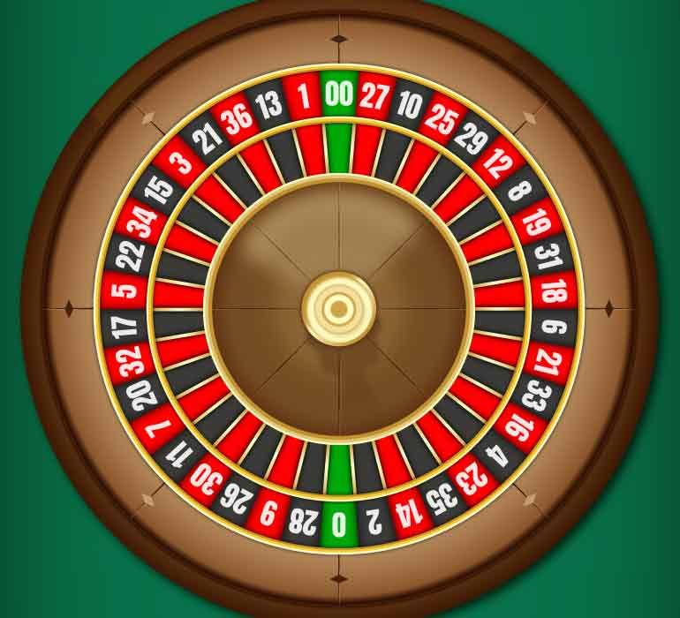
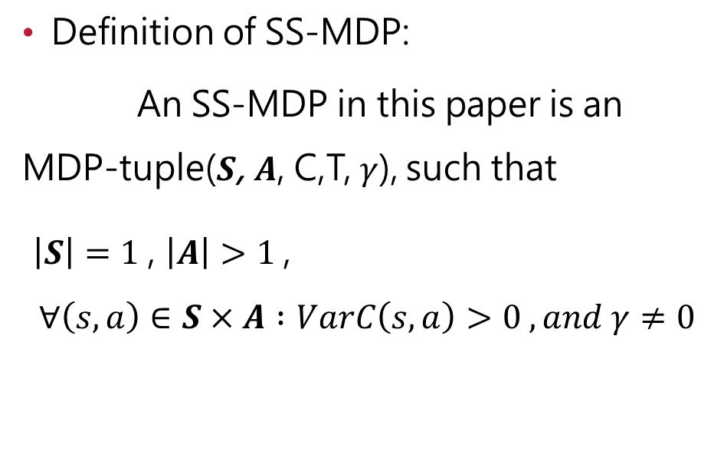
Bias-correction for SS-MDP
Definition of SS-MDP:
An SS-MDP in this paper is an MDP-tuple($S$, $A$, C,T,$γ$), such that
$\left|S\right|=1$, $\left|A\right|>1$,
$$∀\left(s,a\right)∈S×A :VarC\left(s,a\right)>0 ,and γ≠0$$

Slide 10

Bias-correction for SS-MDP
Environment : The game of Roulette
The degree of action space : 38
Single state
Pure exploration policy
Discount factor $γ=0.99$
The expectation of reward :
Betting: -$0.0526
No-betting : $0

Slide 11
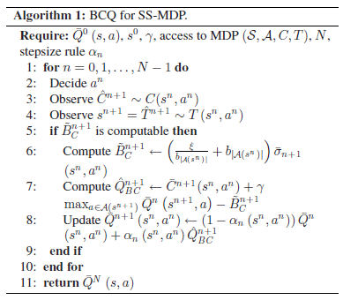

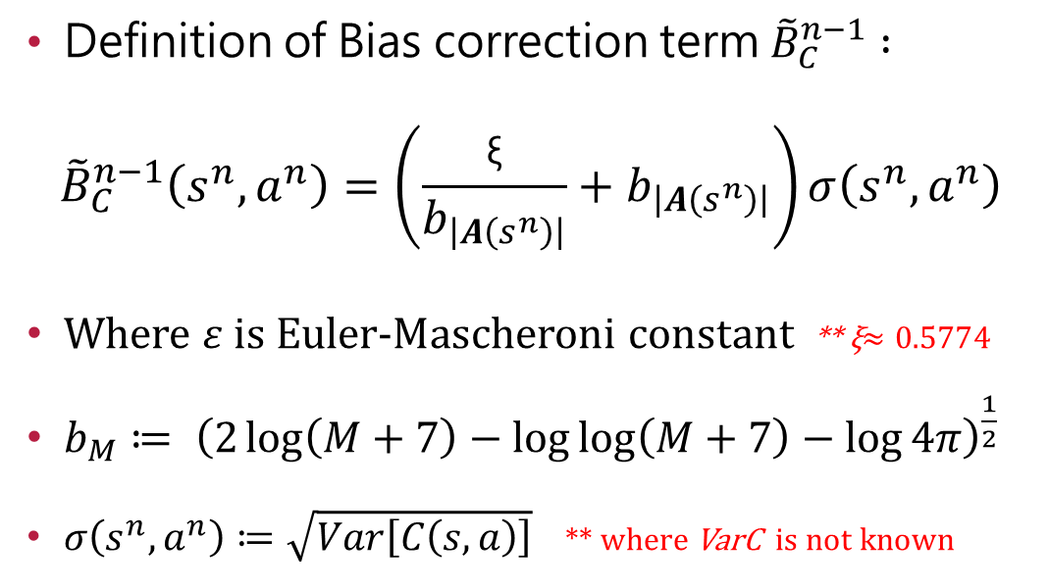
Solve $B_{C}^{n}$ for SS-MDP
Definition of Bias correction term ${\tilde{B}}_{C}^{n−1} :$
$${\tilde{B}}_{C}^{n−1}\left(s^{n},a^{n}\right)=\left(\frac{\text{ξ}}{b_{\left|A\left(s^{n}\right)\right|}}+b_{\left|A\left(s^{n}\right)\right|}\right)σ\left(s^{n},a^{n}\right)$$
Where $ε$ is Euler-Mascheroni constant ** ξ$≈0.5774$
$b_{M}≔ {\left(2\log\left(M+7\right)−\log{\log\left(M+7\right)}−\log{4π}\right)}^{\frac{1}{2}}$
$σ\left(s^{n},a^{n}\right)≔\sqrt{Var\left[C\left(s,a\right)\right]}$ ** where VarC is not known

Slide 12

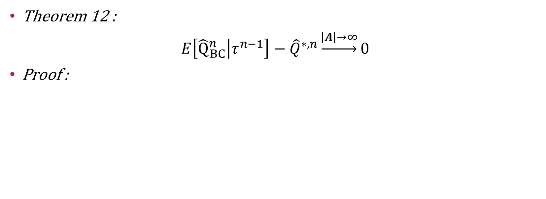
Solve $B_{C}^{n}$for SS-MDP
Theorem 12 :
$$E\left[{\hat{Q}}_{BC}^{n}\left|τ^{n−1}\right.\right]−{\hat{Q}}^{∗,n}\underset{→}{\left|A\right|\underset{→}{}∞}0$$
Proof :

Slide 13
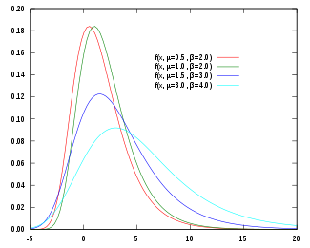
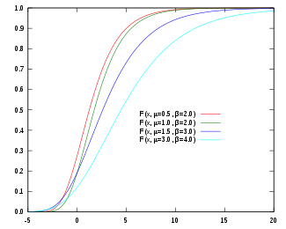
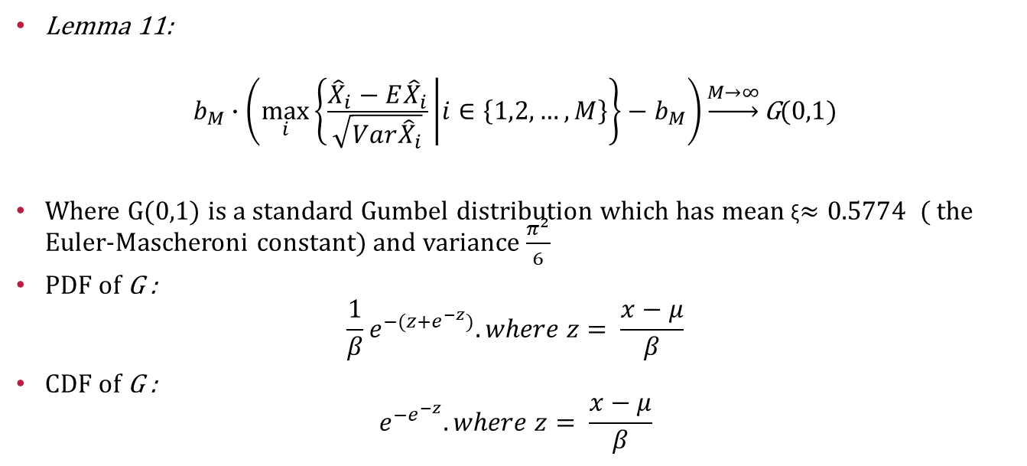
Solve $B_{C}^{n}$for SS-MDP
Lemma 11:
$$b_{M}∙\left(\max_{i}\left\{\frac{{\hat{X}}_{i}−E{\hat{X}}_{i}}{\sqrt{Var{\hat{X}}_{i}}} | i∈\left\{1,2,…,M\right\}\right\}−b_{M}\right)\underset{→}{M→∞}\text{G}\text{(0,1)}$$
Where G(0,1) is a standard Gumbel distribution which has mean ξ$≈0.5774$ ( the Euler-Mascheroni constant) and variance $\frac{π^{2}}{6}$
PDF of G :
$$\frac{1}{β}e^{−(z+e^{−z})}.where z= \frac{x−μ}{β}$$
CDF of G :
$$e^{−e^{−z}}.where z= \frac{x−μ}{β}$$

Slide 14
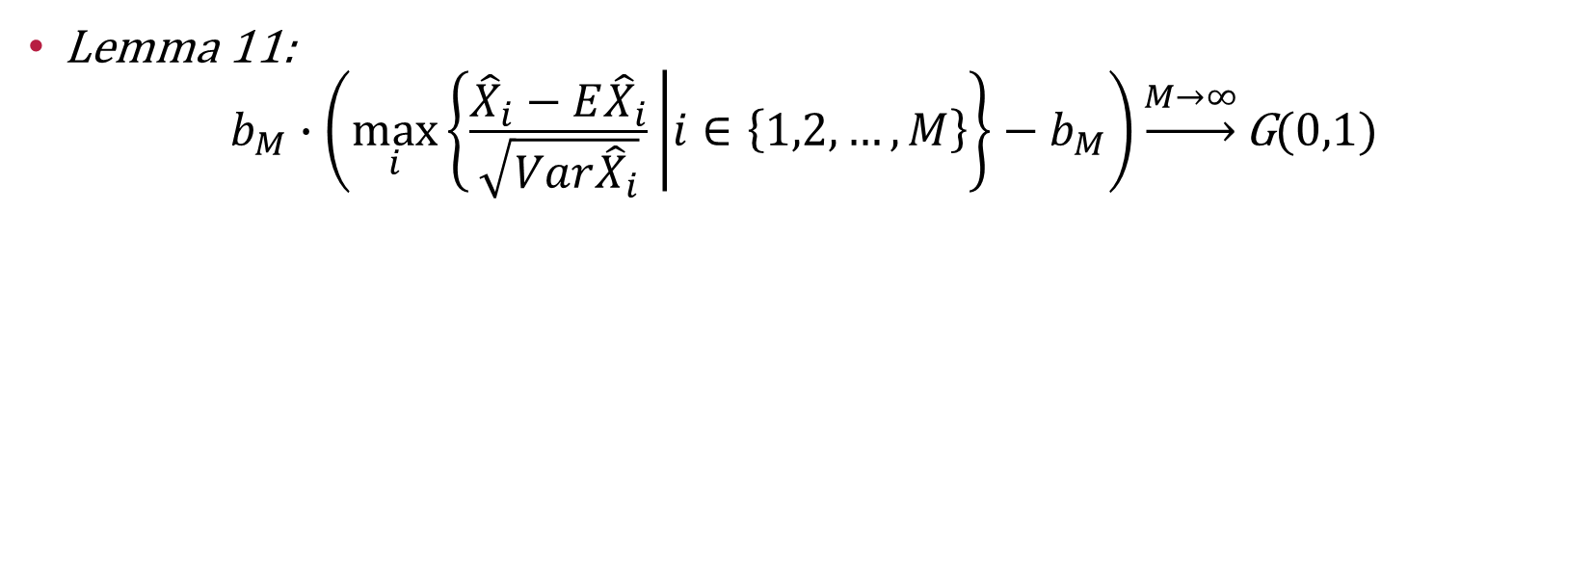
Solve $B_{C}^{n}$for SS-MDP
Lemma 11:
$$b_{M}∙\left(\max_{i}\left\{\frac{{\hat{X}}_{i}−E{\hat{X}}_{i}}{\sqrt{Var{\hat{X}}_{i}}} | i∈\left\{1,2,…,M\right\}\right\}−b_{M}\right)\underset{→}{M→∞}\text{G}\text{(0,1)}$$
Target :

Slide 15
Solve $B_{C}^{n}$ for SS-MDP
Target :

Slide 16
Solve $B_{C}^{n}$ for SS-MDP

Slide 17

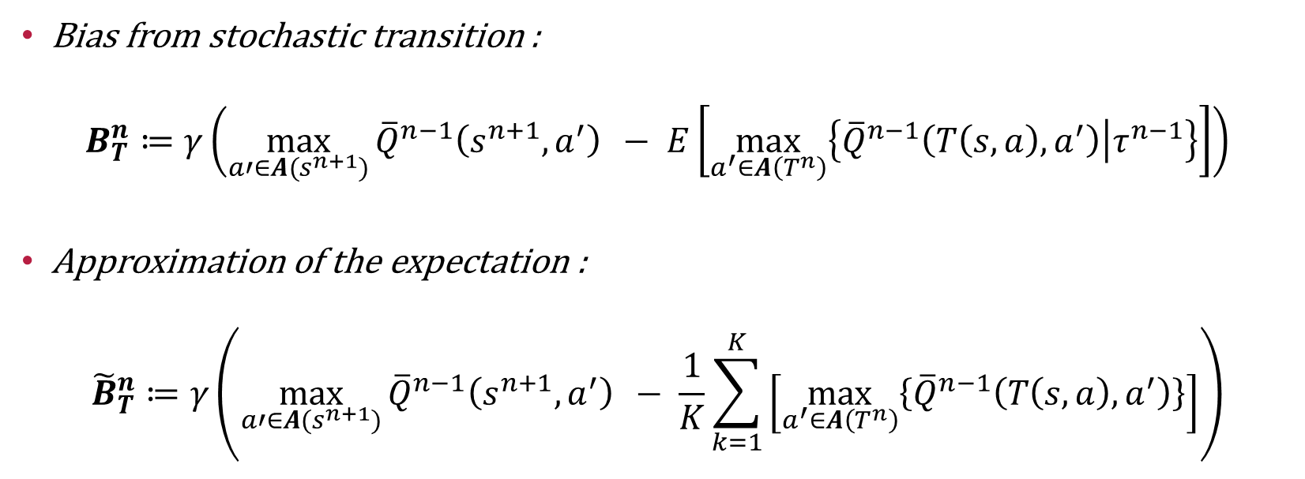
Solve $B_{T}^{n}$for BCQ-ME
Bias from stochastic transition :
$$B_{T}^{n}≔γ\left(\max_{a′∈A(s^{n+1})}{{\overline{Q}}^{n−1}\left(s^{n+1},a^{′}\right)} − E\left[\max_{a^{′}∈A\left(T^{n}\right)}\left\{{\overline{Q}}^{n−1}\left(T\left(s,a\right),a^{′}\right)\left|τ^{n−1}\right.\right\}\right]\right)$$
Approximation of the expectation :
$${\tilde{B}}_{T}^{n}≔γ\left(\max_{a′∈A(s^{n+1})}{{\overline{Q}}^{n−1}\left(s^{n+1},a^{′}\right)} − \frac{1}{K}\sum_{k=1}^{K}{\left[\max_{a^{′}∈A\left(T^{n}\right)}\left\{{\overline{Q}}^{n−1}\left(T\left(s,a\right),a^{′}\right)\right\}\right]}\right)$$

Slide 18
Solve $B_{T}^{n}$for BCQ-ME

Slide 19
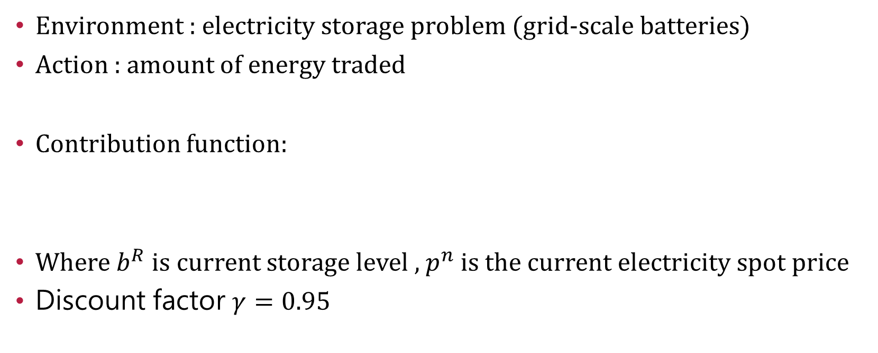
Bias-correction for BCQ-ME
Environment : electricity storage problem (grid-scale batteries)
Action : amount of energy traded
Contribution function:
Where $b^{R}$is current storage level , $p^{n}$ is the current electricity spot price
Discount factor $γ=0.95$

Slide 20
Bias-correction for BCQ-ME

Slide 21
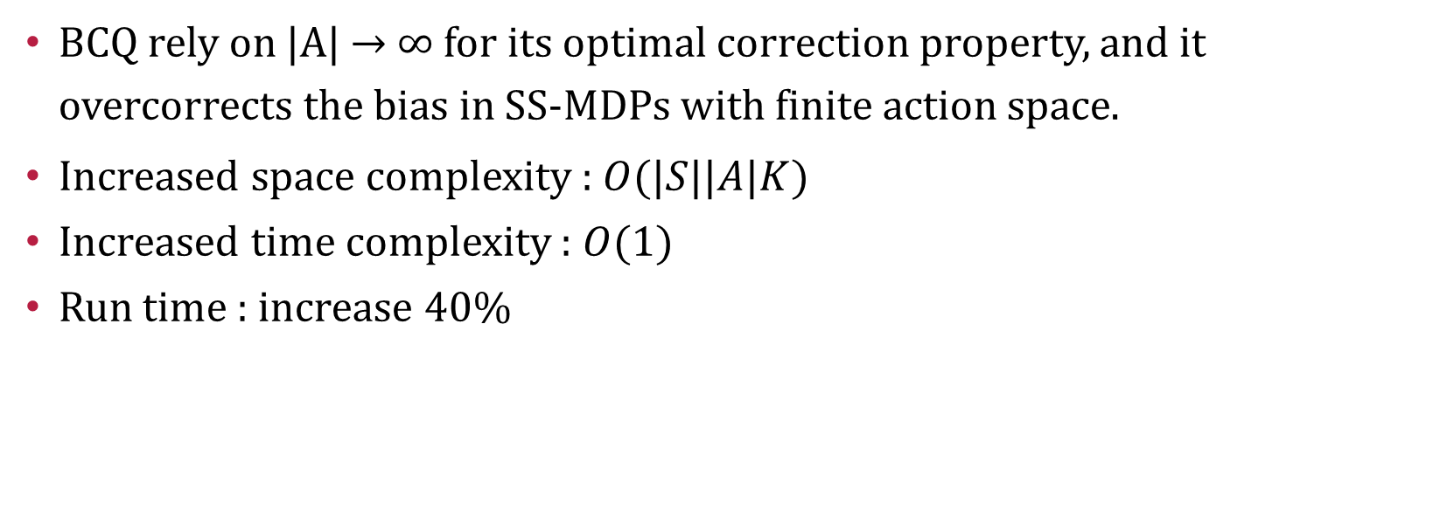
Discussion of the author
BCQ rely on |A| → ∞ for its optimal correction property, and it overcorrects the bias in SS-MDPs with finite action space.
Increased space complexity : $O(|S||A|K)$
Increased time complexity : $O(1)$
Run time : increase 40%

Slide 22
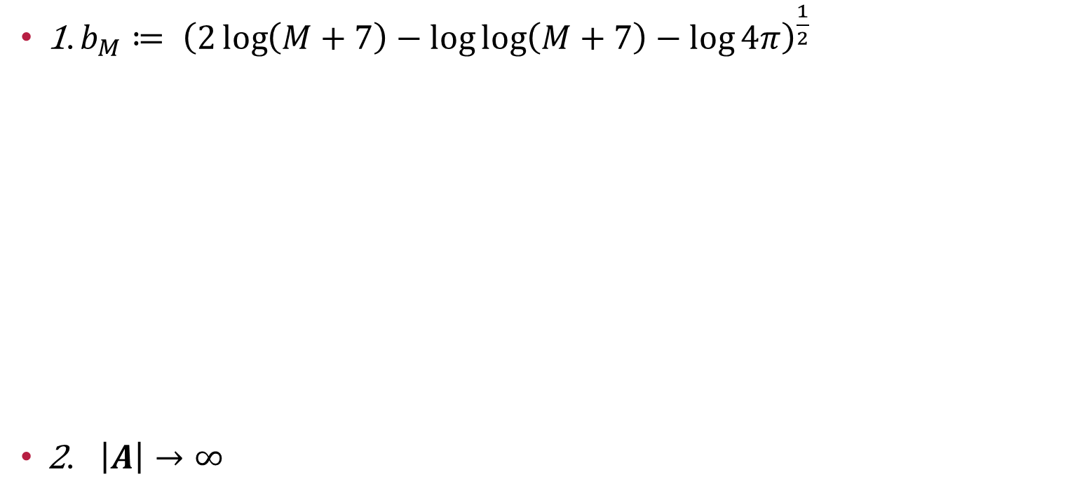
Discussion for final
1. $b_{M}≔ {\left(2\log\left(M+7\right)−\log{\log\left(M+7\right)}−\log{4π}\right)}^{\frac{1}{2}}$
2. $\left|A\right|→∞$

Slide 23
Thanks for your attention.

